Slide 1
Node Js

Slide 2
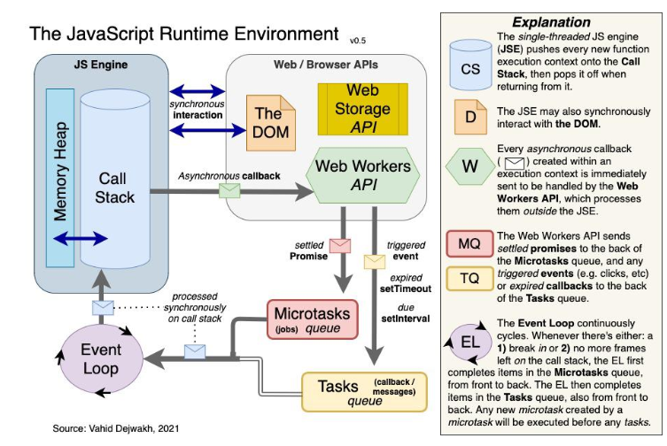
https://vahid.blog/post/2021-03-21-understanding-the-javascript-runtime-environment-and-dom-nodes/

Slide 3
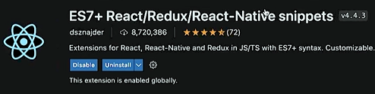
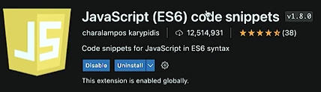
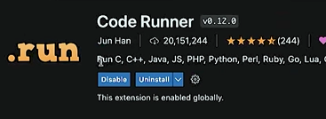
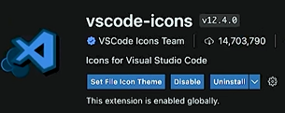
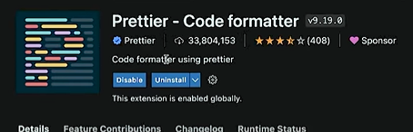

Extentions for node jsśś

Slide 4
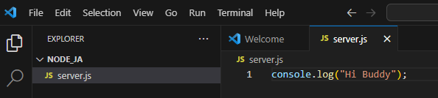
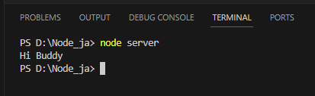
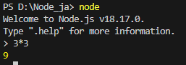
Chrome V8 engine is node_js
instead of Window obj here we use global obj because of no browser available
Only vennila js uses window obj
We can directly enter node and ctrl+d to close it

Slide 5
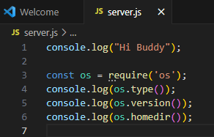
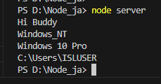
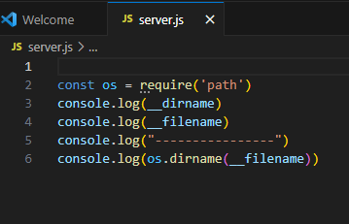
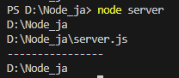
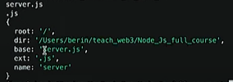
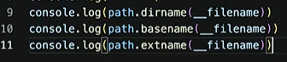
ES6 is not adopted in node js so we can’t directly import js code from another file SO We use require( ) for that .

Slide 6
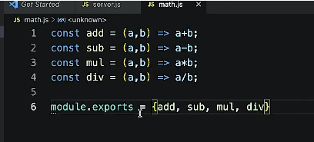
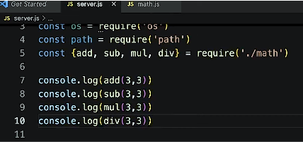
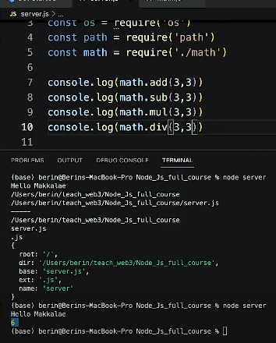
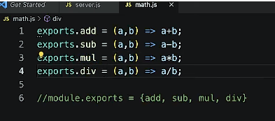
←We can export like this
←We can import like this Array destructuring also
←We can import like this
←We can also export like this

Slide 7
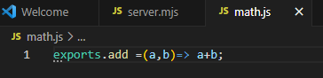
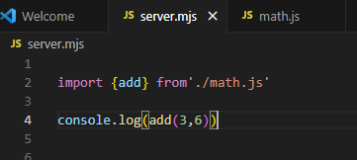
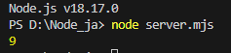
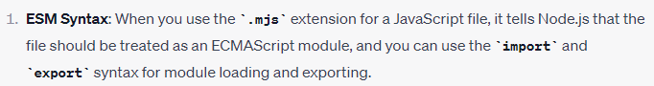
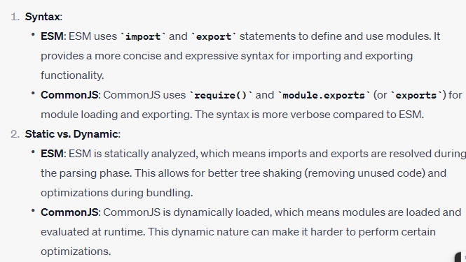
←to use import we should save it .mjs

Slide 8
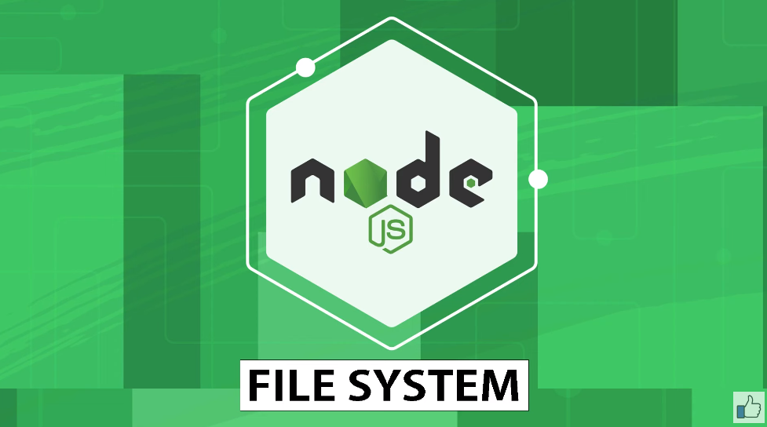

Slide 9
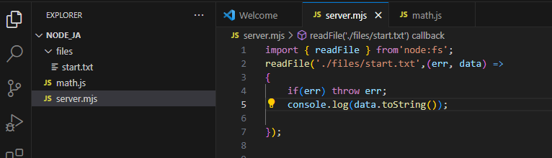
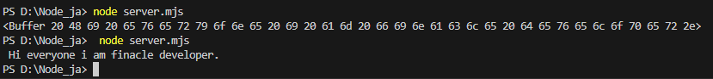
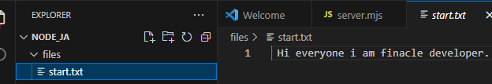
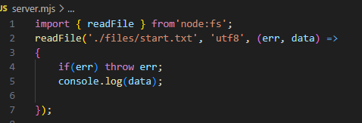
File Reading
With and without toString( )
←or we can specify format

Slide 10
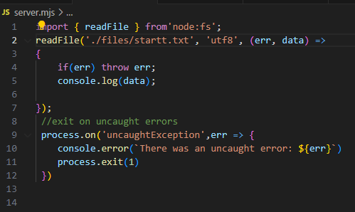
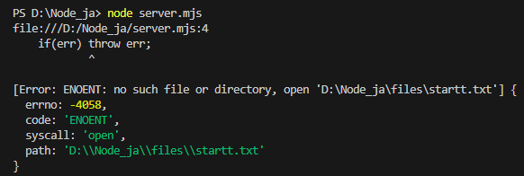
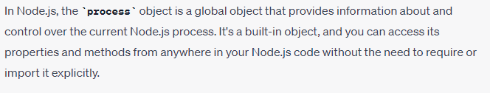
←without exit
FILE SYSTEM working asychronously

Slide 11
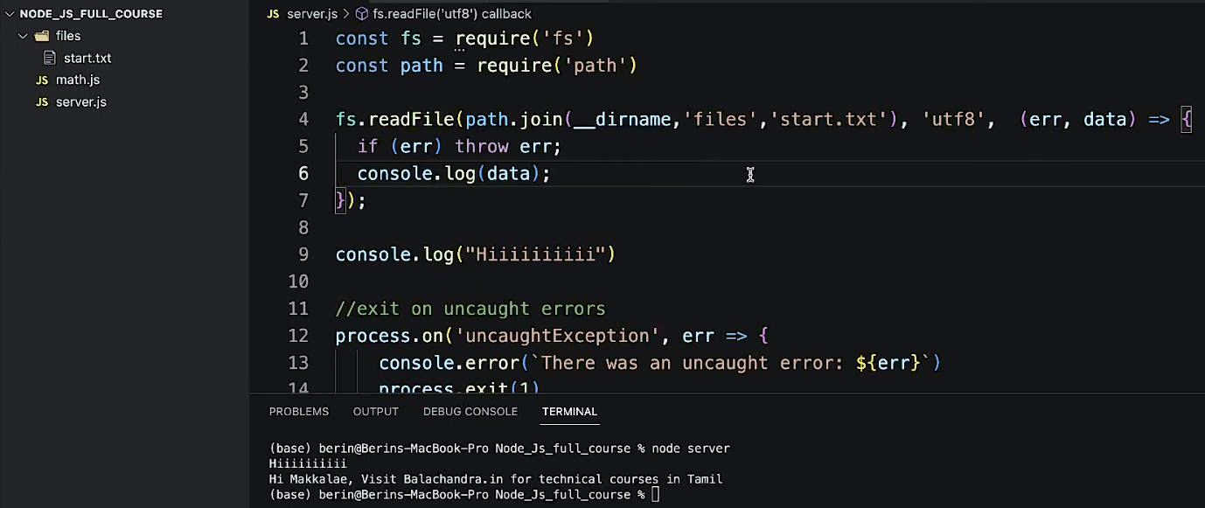
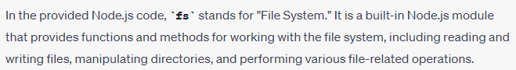
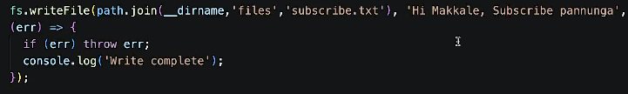
USING REQUIRE WE FORM LINK SO WE CAN AVOID MISTAKES LIKE / OR \ SYMBOL IN DIFFERENT OS
File Writing

Slide 12
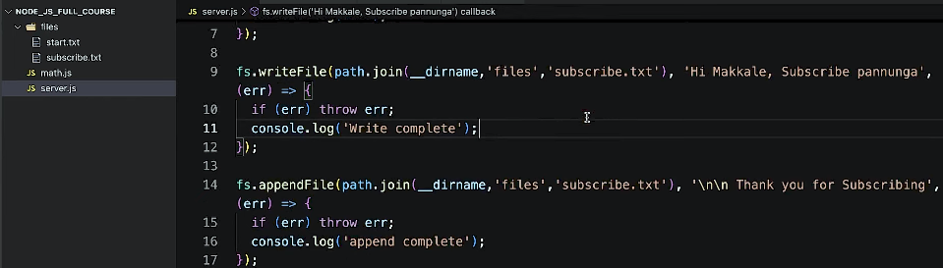
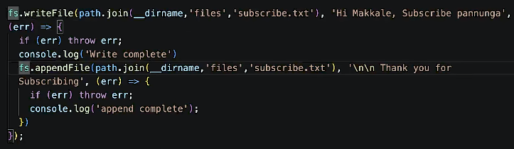
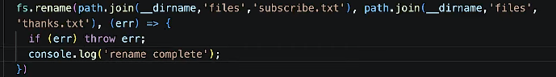
This will not work properly beacause files working asynchronously
We can even create new file using append
So this will work
This is used to Rename the file name

Slide 13
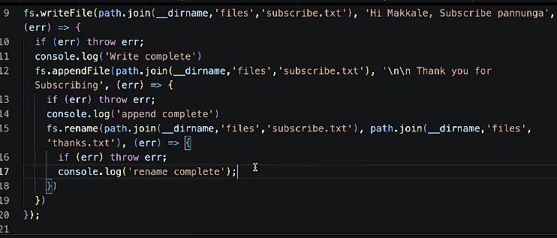
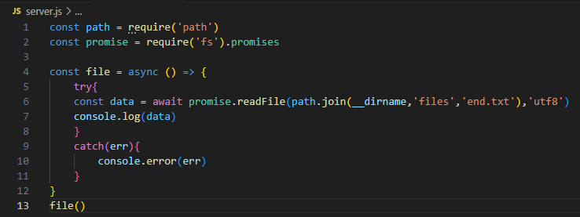
Writing functions like this in asynchronous js called call back hell
Async and await
Using Async and await function using promises

Slide 14
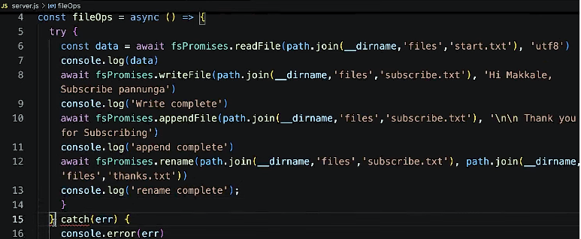
Async and await
Using Async and await function using promises
To delete a file

Slide 15
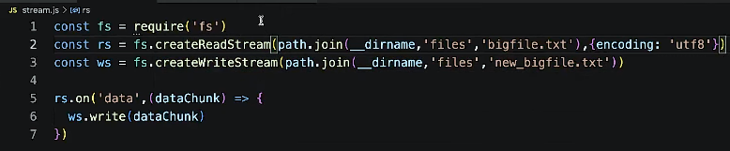
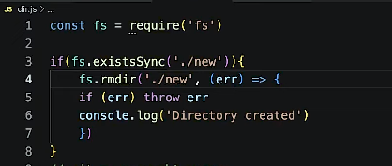
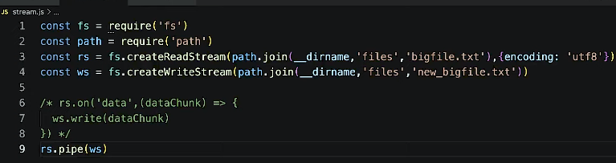
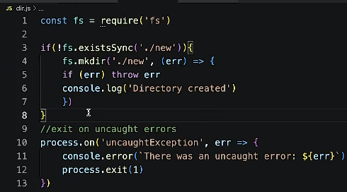
Big Files reading
To remove folder →
rs.on is a listner
To make folder
Efficient way
This line checks for already folder is available

Slide 16
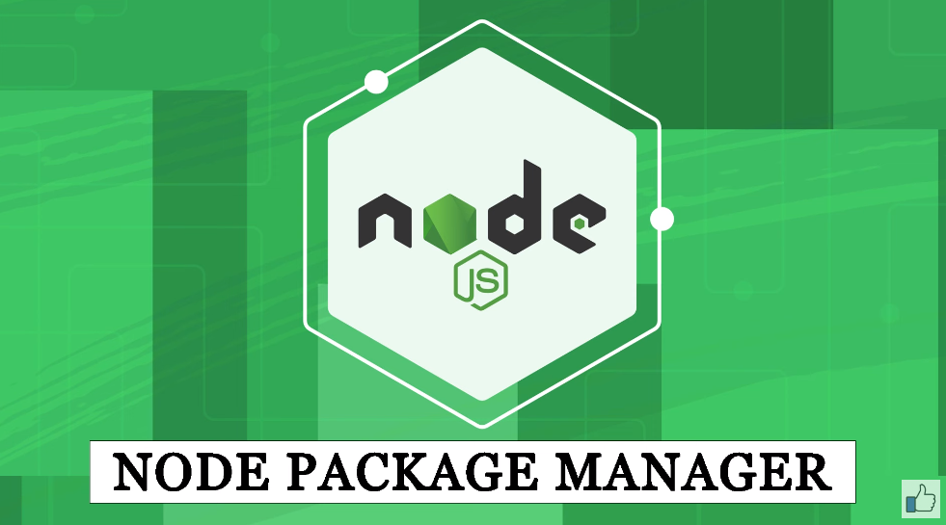

Slide 17
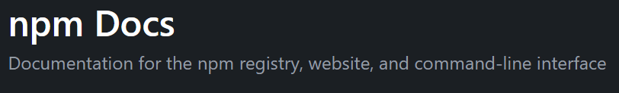
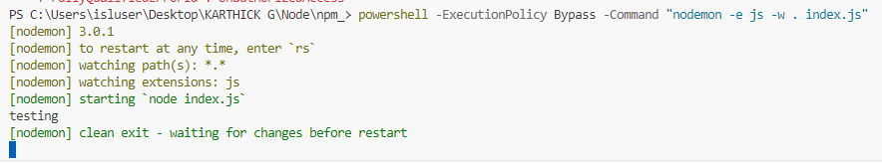
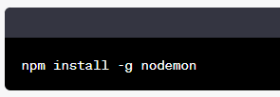
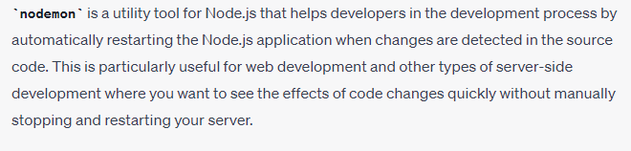
nodemon
https://docs.npmjs.com/
This comment will intall nodemon globally
And when called nodemon it executes index.js automatically
If we want run another file we must specify name of file explicitly
Whenver we made changes to index file it will automatically get executed without even calling
CTRL+C to close nodemon mode
OR

Slide 18


Slide 19





OR
-y will simply create default package.json without asking

Slide 20


We can download this npm modules for our specific project directory using this command
No need to look into package-lock.json

Slide 21



When we deploy our project node moules from our project is not needed because it will consume more memory
So we can remove them when we push it in git by specifying the names in .gitignore
-D means this dependency is only for development
When we import projects we must use npm install ,then only we it will look for package.json file then install necessary dependencies specified in that file
So no need to copy the node_modules

Slide 22


This comment will start nodemon index
Else we can use npm start also ,It will run node index.js

Slide 23




UUID
OR
In server side logs for unique identification numbers this uuid is used

Slide 24



In this line uuid is alias ,in import alias is used by ‘as’. In require it is used after ‘ : ‘

Slide 25

When we use rm to remove some module it will be still available in index.js so we must remove it from json fil also

Slide 26




When using npm update In this ~2.30.0
2 is major version
30 is minor version
0 is patch
^this is used to not to update major version we can update other versions
~ this is used to can ‘t update major and minor version ,only update patch
* we can update all dependency
We can install particular version also by specifying it.

Slide 27


Slide 28


Slide 29

myEmitter object name we can give any name.
That objects emits message in the name of log
.on listener listen’s to the event whenever log event happens then do that work
So name log should be same in emit and listen parts

Slide 30


https://www.npmjs.com/package/events

Slide 31


Slide 32


Slide 33



Slide 34

We can give response in res.end() itself
In this if already an environment port number is available then it takes that number otherwise it takes 3500
https://github.com/gitdagray/nodejs_web_server

Slide 35
THANK
YOU

